Slide 1
Source Control
git

Slide 2
git
Created by Linus Torvalds in 2005
Creator of Linux OS Kernel
Fast
Distributed
Data Integrity
Staging Area
Open Source
The Standard
Any decent IDE is integrated with git and gitHub
github has 190M repos as of Jan 2020

Slide 3
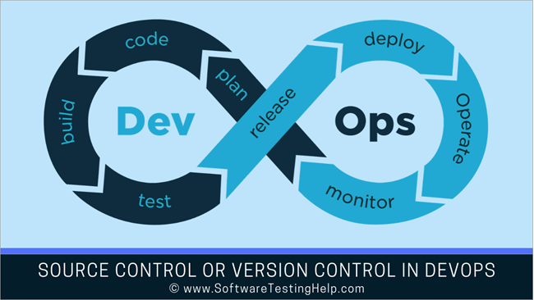
DevOps Life Cycle

Slide 4

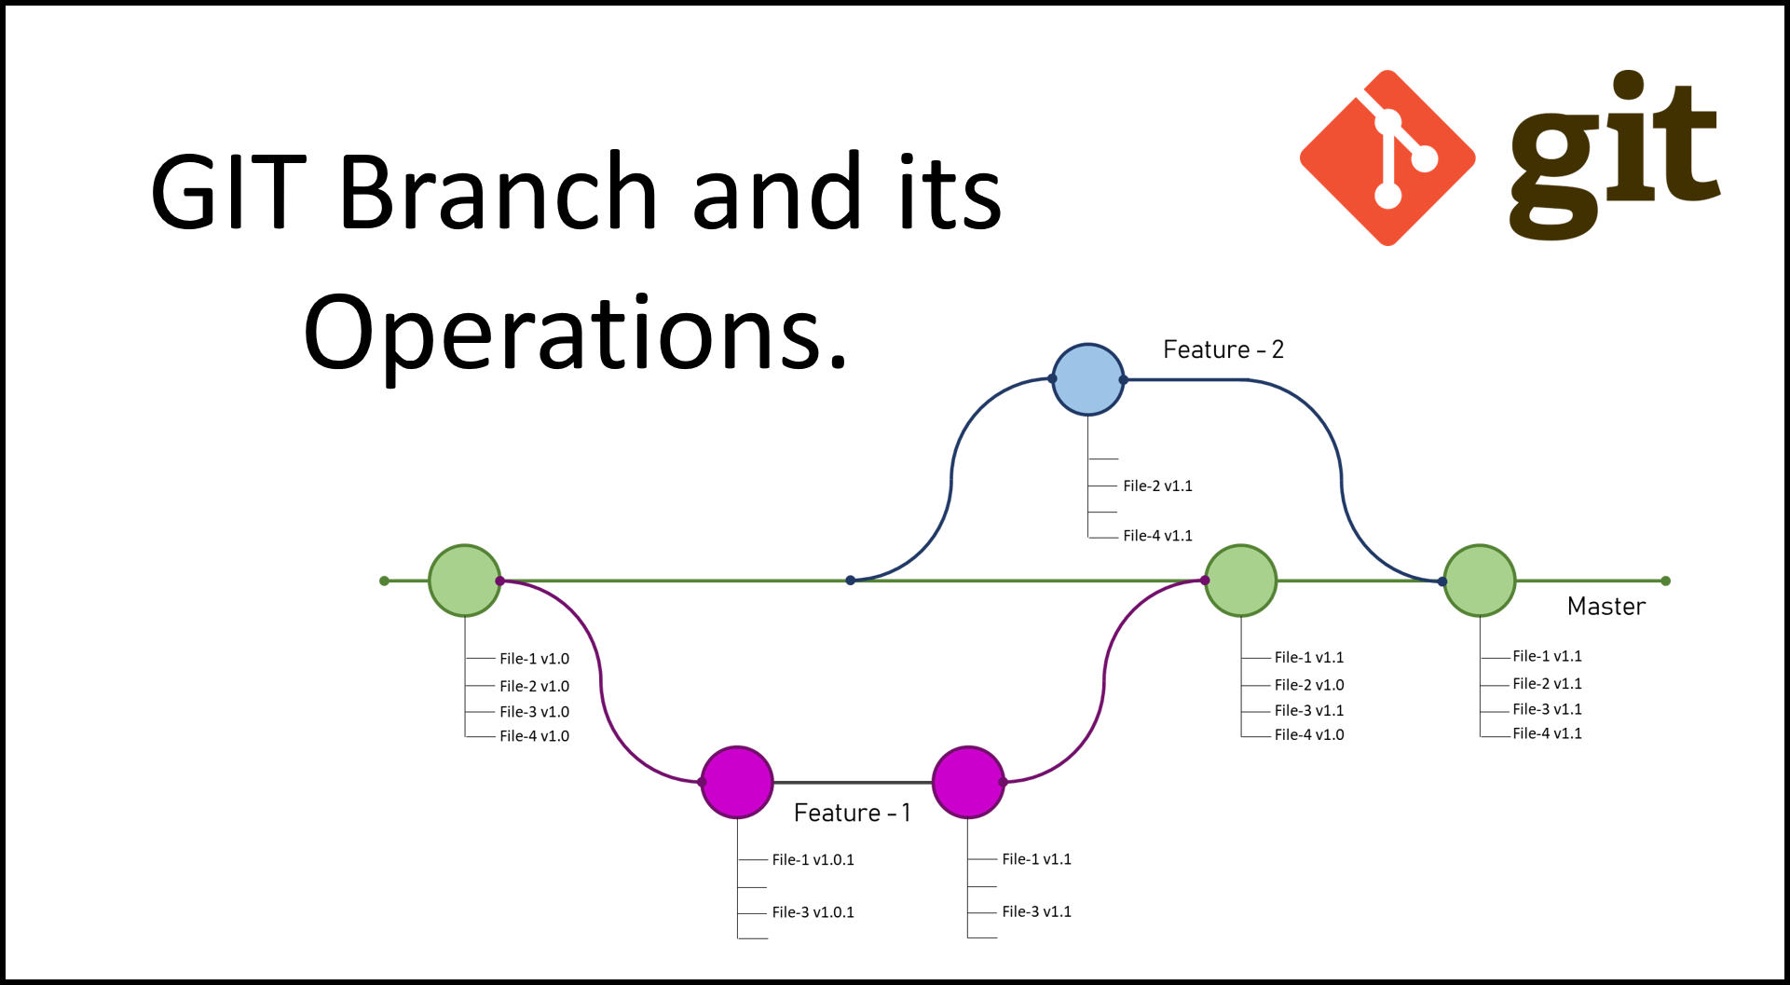


Slide 5
Main /Master

Slide 6
Git project
Working
Everyone has a full ‘working’ copy of the project
Do all the damage you want, and you don’t affect your team
Staging
Your next draft of the project
You have something you are happy with
Repo
The final word
Hosts the latest and greatest version of everyone’s code

Slide 7
Version Control System Attributes Who do we blame
Complete history of every change
Who
When
What
Why

Slide 8
Git Life-Cycle
Version 1 – Golden works great. Everyone loves it
Version 2 – What happened? Old features are broken
Revert production to Version 1
Compare the versions(
Analyze what changed
Identify (Blame) the contributor
Repair, test, promote
Version 2.1 yay! things are better

Slide 9
Commit often
Commits are cheap and easy to make.
Make frequently to capture updates to a code base.
Each commit is a snapshot that the codebase can be reverted to if needed.
Frequent commits give many opportunities to revert or undo work. You have few changes to evaluate when something goes bad between commits

Slide 10
Ensure you're working from latest version
It’s easy to have a local copy of the codebase if you fall behind the global copy. Make sure to git pull or fetch the latest code before making updates. This will help avoid conflicts at merge time.
Fetch – gets current copy of repo
Pull – a fetch PLUS a merge. You have the opportunity to update your code base with your changes and the team’s changes.

Slide 11
What is GitHub pull request?
Pull request is a process for a developer to notify team members that they have completed a feature. Once their feature branch is ready, the developer files a pull request via their remote server account.
The pull request announces to all the team members that they need to review the code and merge it into the master branch.

Slide 12
Make detailed notes
Each commit has a corresponding log entry.
At the time of commit creation, this log entry is populated with a message.
It is important to leave descriptive explanatory commit log messages. These commit log messages should explain the “why” and “what” that encompass the commits content.
These log messages become the canonical history of the project’s development and leave a trail for future contributors to review.

Slide 13
Review changes before committing
The staging area can be used to collect a group of edits before writing them to a commit.
The staging area can be used to manage and review changes before creating the commit snapshot.
Utilizing the staging area in this manner provides a buffer area to help refine the contents of the commit.

Slide 14
Use Branches
Branching is a powerful mechanism that allows developers to create a separate line of development.
Branches should be used frequently as they are quick and inexpensive.
Branches enable multiple developers to work in parallel on separate lines of development.
These lines of development are generally different product features. When development is complete on a branch it is then merged into the main line of development.

Slide 15
Agree on a Workflow
By default, git offers very free form methods of contribution.
It is important that teams establish shared patterns of collaboration.
git workflows establish patterns and processes for merging branches.
If a team doesn't agree on a shared workflow it can lead to inefficient communication overhead when it comes time to merge branches.

Slide 16
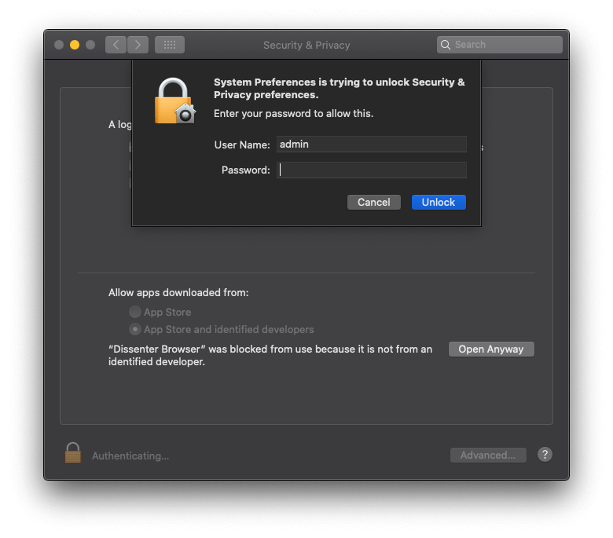
Install git

Slide 17
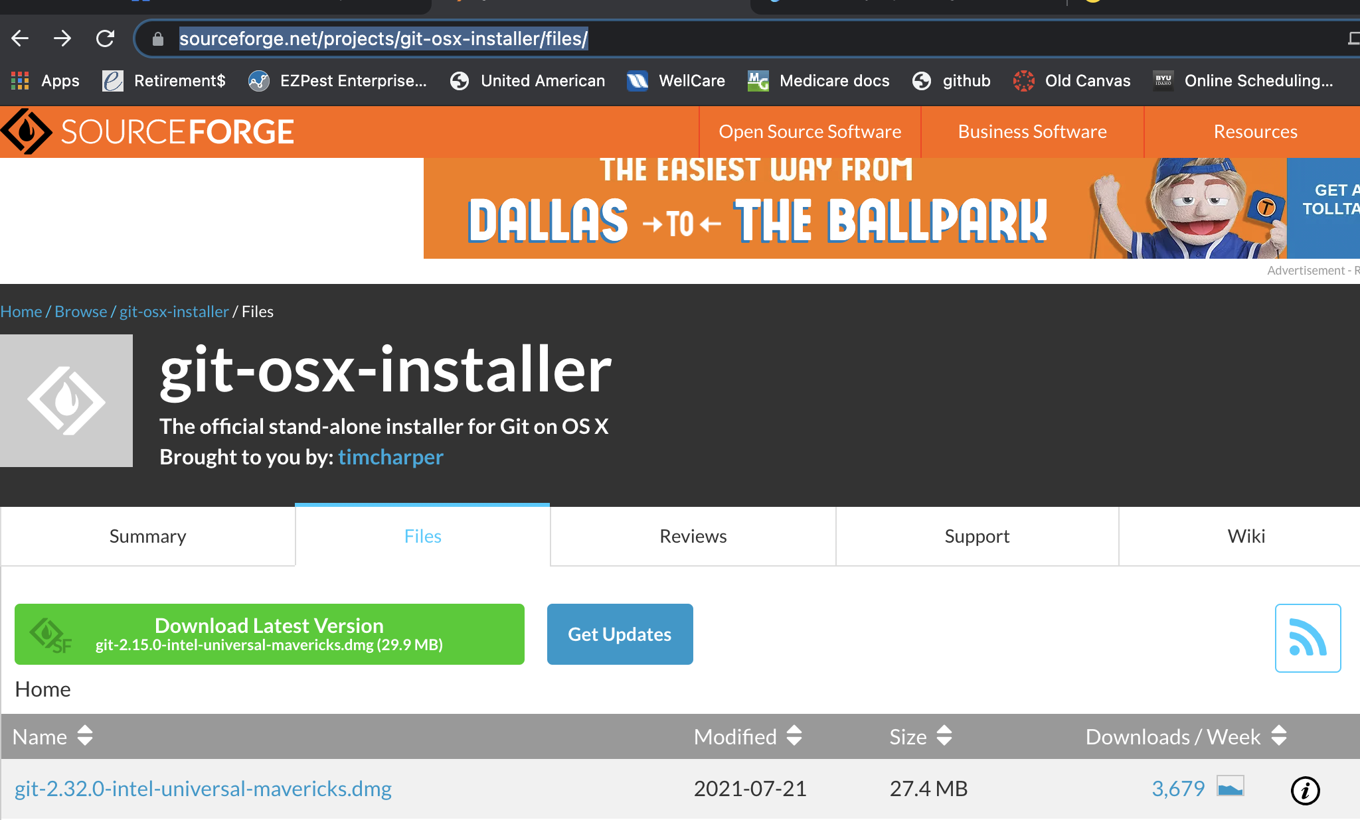
https://sourceforge.net/projects/git-osx-installer/files/

Slide 18
What version? Who are you?
git –version
git config --global user.name ”Gary James”
git config --global user.email gtjames@gmail.com
/.git/config – Repository-specific settings.
~/.gitconfig – User-specific settings. This is where options set with the --global flag are stored.
$(prefix)/etc/gitconfig – System-wide settings.

Slide 19
Starting the repo
git init
The folder is now a repo
The folder might have files in it but the repo empty.
Just do this once
git add . Or names of files
files are now staged
git commit –m “this is what I did”
staged files are now committed to project

Slide 20
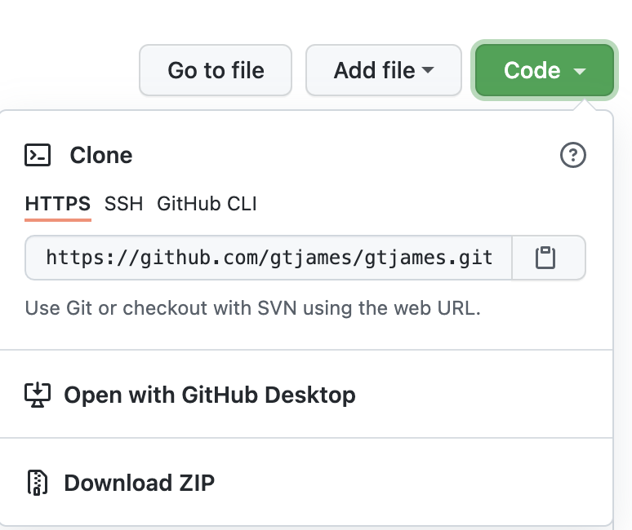
Cloning a Repo
Go to gitHub
Find the Repo you need
Find the Green Code button
Click the ‘clipboard’ icon
This will copy the repo URL
Enter the git clone in your CLI
git clone https://github.com/gtjames/gtjames.github.io.git

Slide 21
What is happening in the repo
Echo “create a dummy file” > file.txt
git status
On branch main
No commits yet
Untracked files:
(use "git add <file>..." to include in what will be committed)
file.txt

Slide 22
What is happening in the repo
git add file.txt
git status
git log
On branch main
No commits yet
Changes to be committed:
(use "git rm --cached <file>..." to unstage)
new file: file.txt

Slide 23
What is happening in the repo
git commit –m “at last a commit!”
git status
git log
On branch main
nothing to commit, working tree clean
Author: gtjames <gtjames@gmail.com>
Date: Thu Sep 2 14:02:04 2021 -0500
at last a commit!

Slide 24
git add Saving Changes
git add
git add . Adds all changed files in folder to staged
git add index.html adds just the single file to the staged list
The git add command adds a change in the working directory to the staging area. It tells git that you want to include updates to a particular file in the next commit.

Slide 25
We interrupt this lecture with an important status message
git status what files are changed or added or new
git diff there we see the diff
git blame Who wrote any line of code
git log All commits
.gitignore
There are usually files created by the IDE you do not want to put in the repo. List the files and directories here
https://www.atlassian.com/git/tutorials/saving-changes/gitignore
Back to our regularly scheduled broadcast

Slide 26
git commit
git commit -m "commit message”
Don’t go cheap on the message!!
The git commit command captures a snapshot of the project's currently staged changes.
Committed snapshots can be thought of as “safe” versions of a project.
git records the entire contents of each file in every commit

Slide 27
Handy Commands
git init my-new-branch
Create a new folder and initialize a repo
ls –la my-new-branch to see all that is created and hidden
git branch –d <branch-name>
Delete a branch
Use –D to delete a branch with uncommitted work

Slide 28
In the root folder of your Project
Step 0 create an empty repo on github
echo "Your Project Name" > README.md // echo node_modules > .gitignore git init git add . git commit -m "first commit" git remote add origin https://github.com/yourID/YourProject.git git push -u origin main

Slide 29
git push
The git push command is used to upload local repository content to a remote repository. Pushing is how you transfer commits from your local repository to a remote repo.
git push is most commonly used to publish an upload local changes to a central repository. After a local repository has been modified a push is executed to share the modifications with remote team members.

Slide 30
git pull
Used to fetch and download content from a remote repository
Updates the local repository to match that content.
Merging remote upstream changes into your local repository is a common task in git-based collaboration work flows.
It’s an easy way to synchronize your local repository with upstream changes.

Slide 31
Branching out
git checkout –b whatever-you-want
Now modify file(s) you want to test
git add file
git status file // check what’s happening
git commit –m ”I’m happy with the change”
git checkout master // how we change branches
git merge whatever-you-want
git log // what happened
git status file // check that nothing is happening

